Slide 1
Batch Experimental Setups: Types

Slide 2
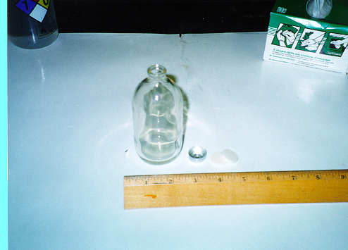
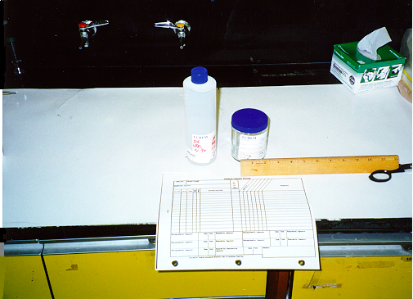
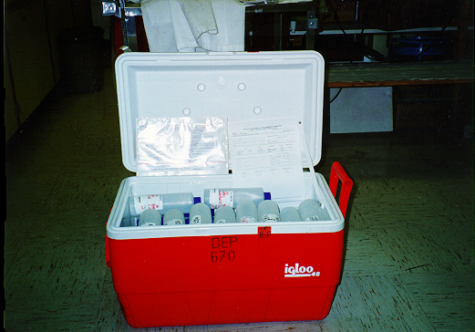
Kinetics or Adsorption
Experiments

Slide 3
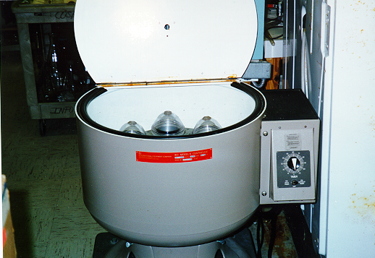
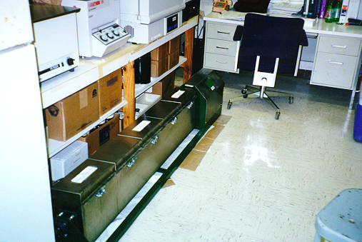
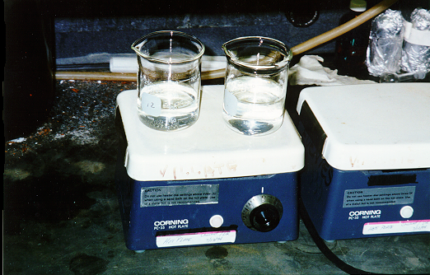

Slide 4
Methodology (con’t)
Concept of Batch Experiment
Step 1
Step 3
Step 2

